Slide 1
Current Challenges
Time consuming process- Engineer need to extract and save Hardwar Hash in USB and then log into an admin portal for uploading Hardwar Hash.
Field Engineers have no access to Admin portal due to which they need SD Team / Autopilot Team help for uploading the Hardwar Hash.
Its very difficulty to extract Hardwar Hash, when device is already delivered to user (For Any kind of troubleshooting's)

Slide 2
Current Process
Engineer need to run the following PS script run (as Administrator) to retrieve Hardware Hash and save it in USB and then log into an admin portal for uploading Hardwar Hash and wait for Profile assignment.
Felid Engineer have no access to Admin portal due to which they involve SD team / Autopilot team help for uploading Hardware Hash.
md c:\HWID
Set-Location c:\HWID
Set-ExecutionPolicy -Scope Process -ExecutionPolicy Unrestricted -Force
Install-Script -Name Get-WindowsAutopilotInfo -Force
Get-WindowsAutopilotInfo.ps1 -OutputFile AutopilotHWID.csv

Slide 3
Problem Statement
Felid Engineer have no access to Admin portal due to which they need SD team help for uploading Hardware Hash.
Its difficulty to extract Hardware hash , when device is already delivered to user.
Time consuming process
Solution
Install Microsoft.Graph.Intune module and add necessary users and groups in “Microsoft Intune PowerShell App” under Users & Groups so that they can upload Hardware hash directly from OOBE screen. This will reduce Hardware hash upload time.
https://github.com/microsoft/Intune-PowerShell-SDK

Slide 4
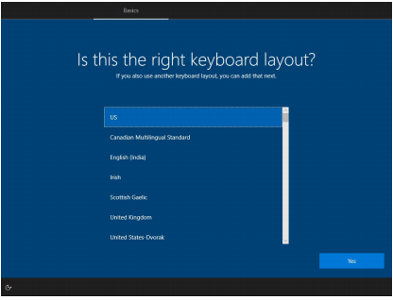
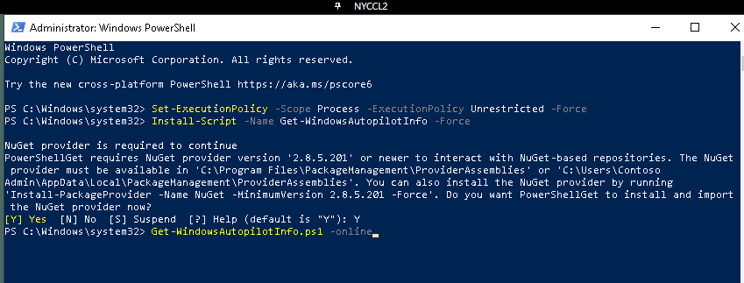
Client Side Experience (With New Process)
Run PowerShell Script during OOBE Screen
Press Shift+f10 and type below command one by one
Powershell.exe
Set-ExecutionPolicy -Scope Process -ExecutionPolicy Unrestricted -Force
Install-Script -Name Get-WindowsAutopilotInfo -Force
Get-WindowsAutopilotInfo.ps1 –online –assign
E.g.-> Get-WindowsAutoPilotInfo.ps1 -GroupTag OwnPC -Online -AddToGroup "AutoPilot_On_Users_OwnPC" -Assign

Slide 5
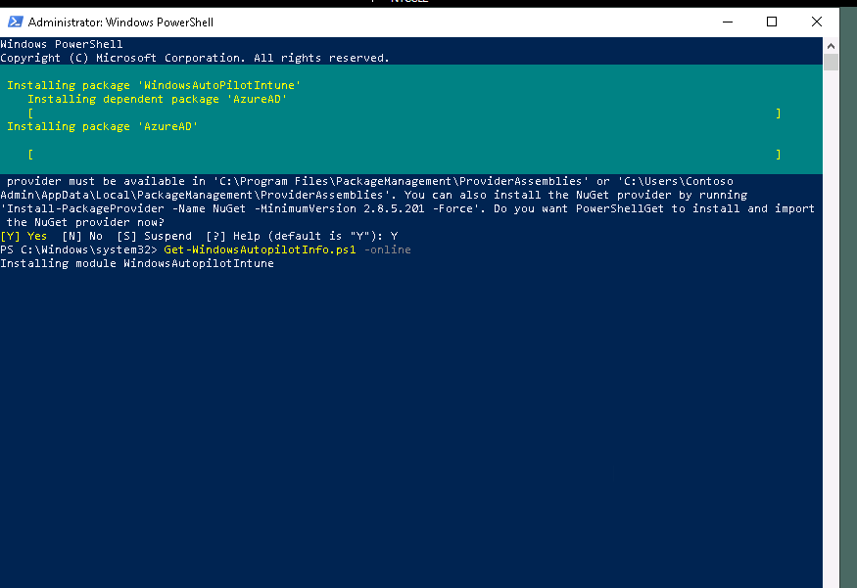
Script downloading and installing necessary autopilot module

Slide 6
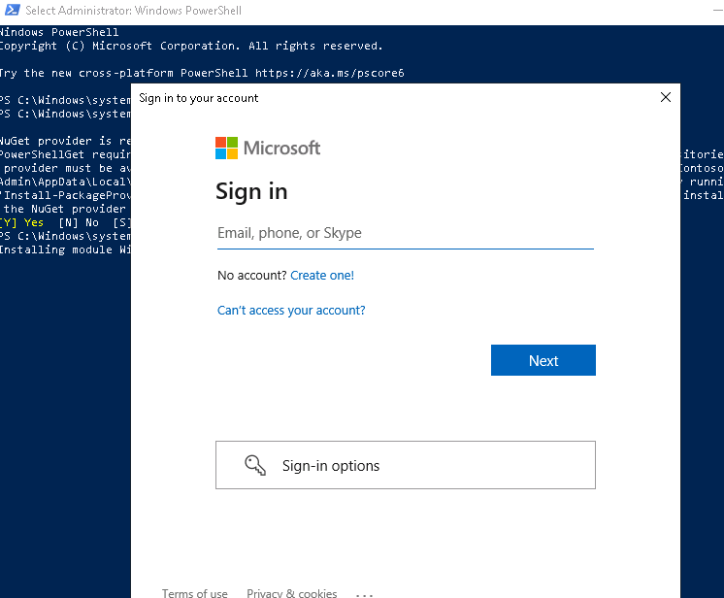
User Email and Password

Slide 7
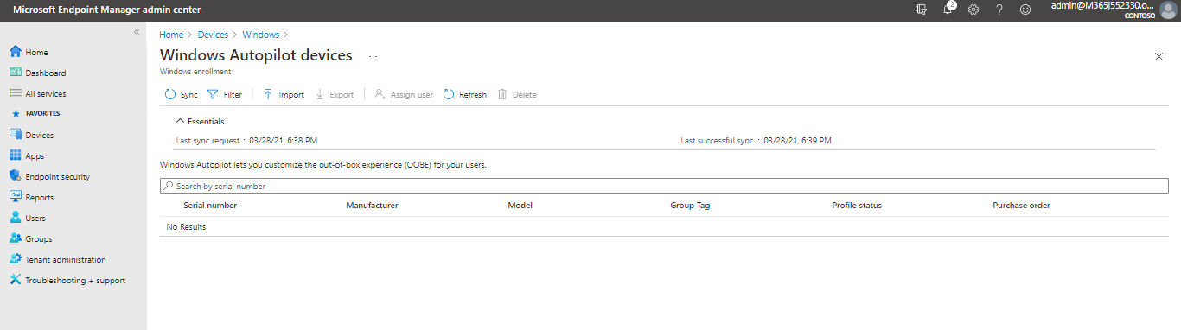
Before Running Script (Hardwar Hash not present)

Slide 8
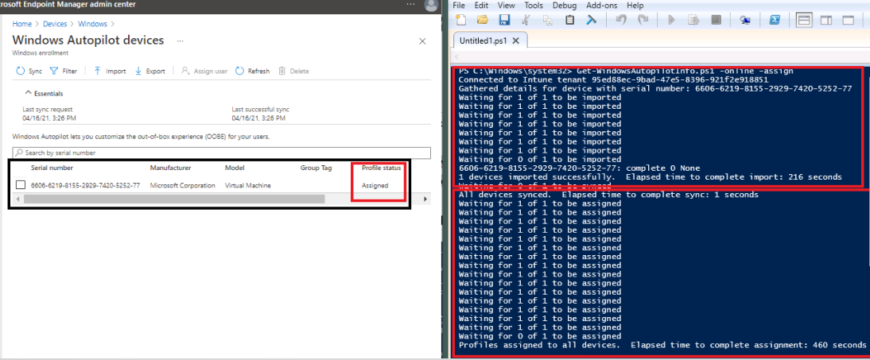
After Running Script (Hardwar Hash uploaded Successfully)

Slide 9
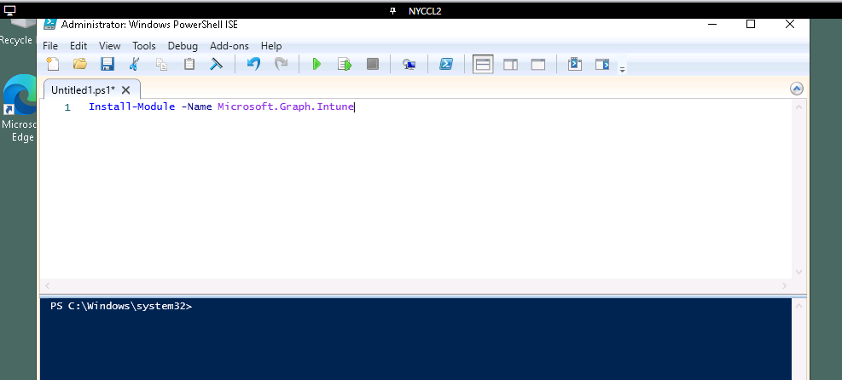
Server Side Configuration
Install Microsoft Intune PowerShell SDK and Provide consent to use this app.
https://github.com/microsoft/Intune-PowerShell-SDK
Step -1
Install-Module -Name Microsoft.Graph.Intune

Slide 10
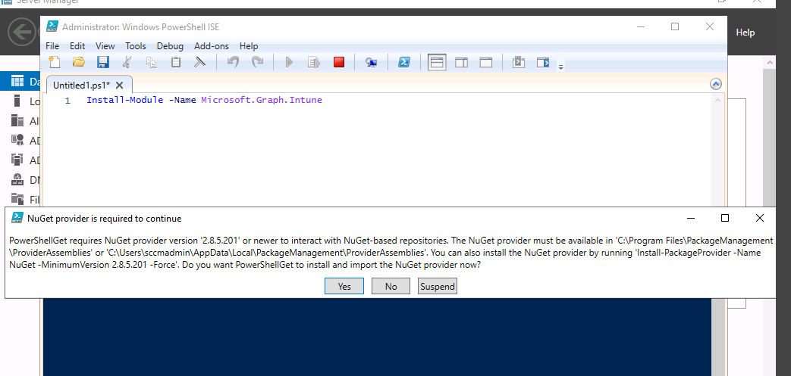
Step -2
An admin user must provide consent for this app to be used in their organization. This can be done with the following command:
Connect-MSGraph -AdminConsent

Slide 11
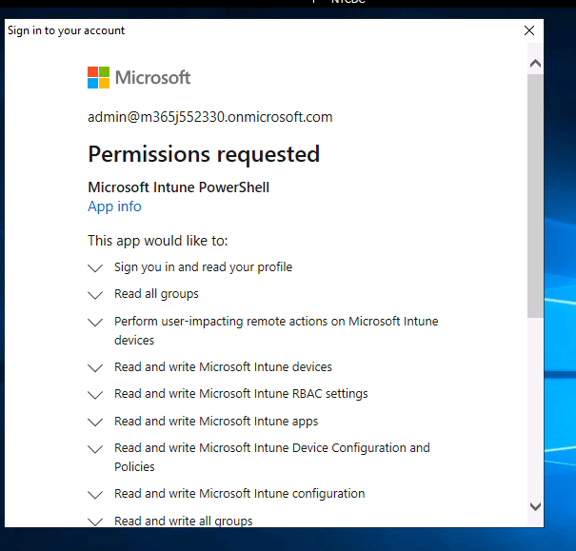
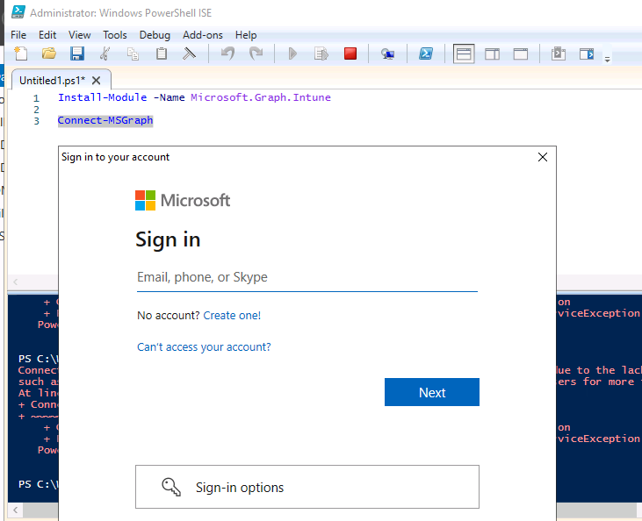
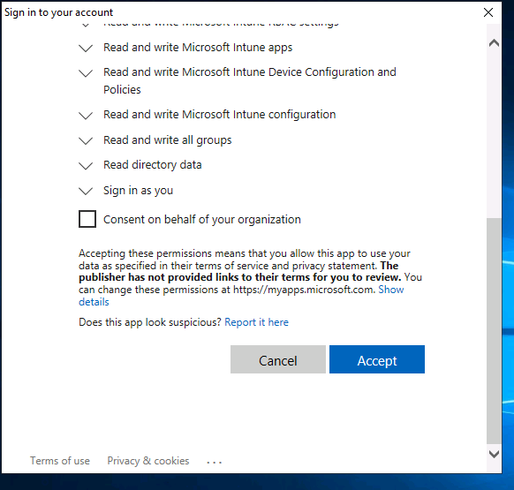

Slide 12
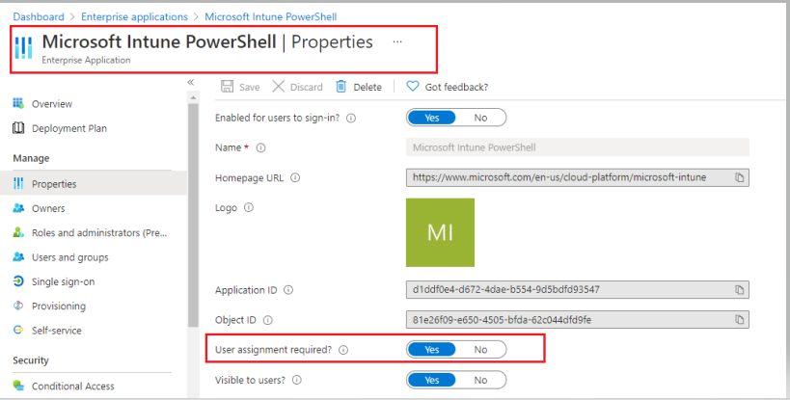
Step -3
Go to the Microsoft Intune PowerShell application under AZURE AD, hit properties and say yes to User Assignment required.

Slide 13
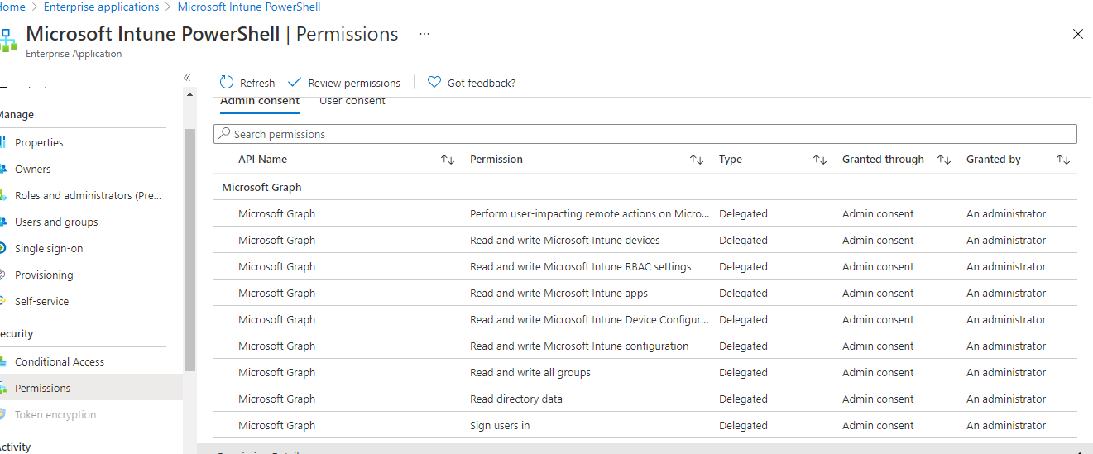
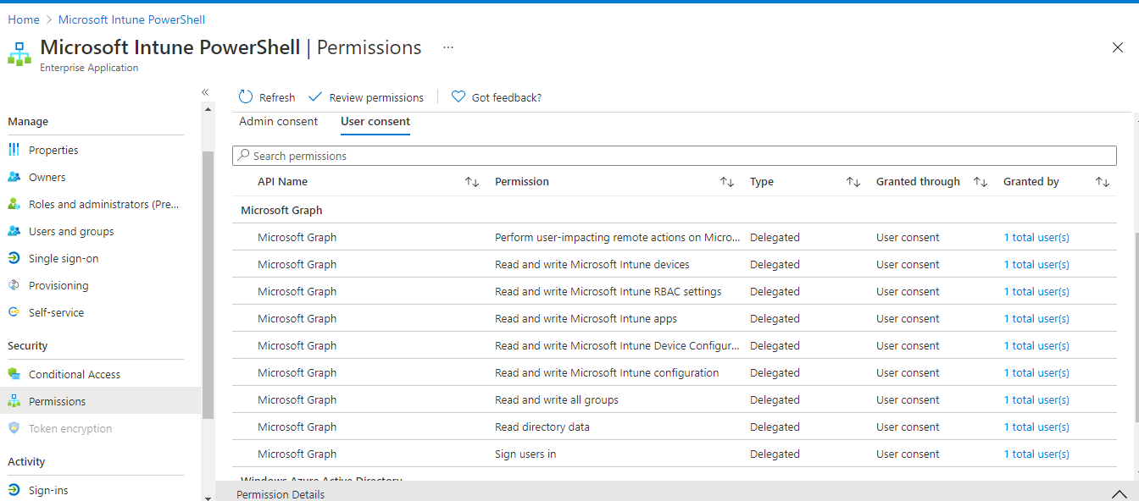
Step -4
Approve Admin Consent and User Consent Under Permissions

Slide 14
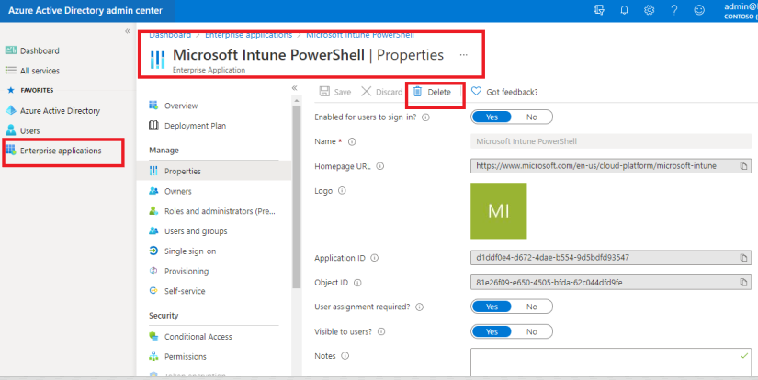
Step - 5
Add necessary users and groups in “Microsoft Intune PowerShell App” under Users & Groups
Groups Name
S-Global Intune - Service Desk L1
S-Global Intune - Service Desk L2
Elekta FE (New Group)
Adhoc User Group (New Group)
Roll Back Plan
Go to the Microsoft Intune PowerShell application under AZURE AD, hit properties and delete the application.

